Slide 1
OverDrive Track Editor
User Guide
ver 1.2

Slide 2
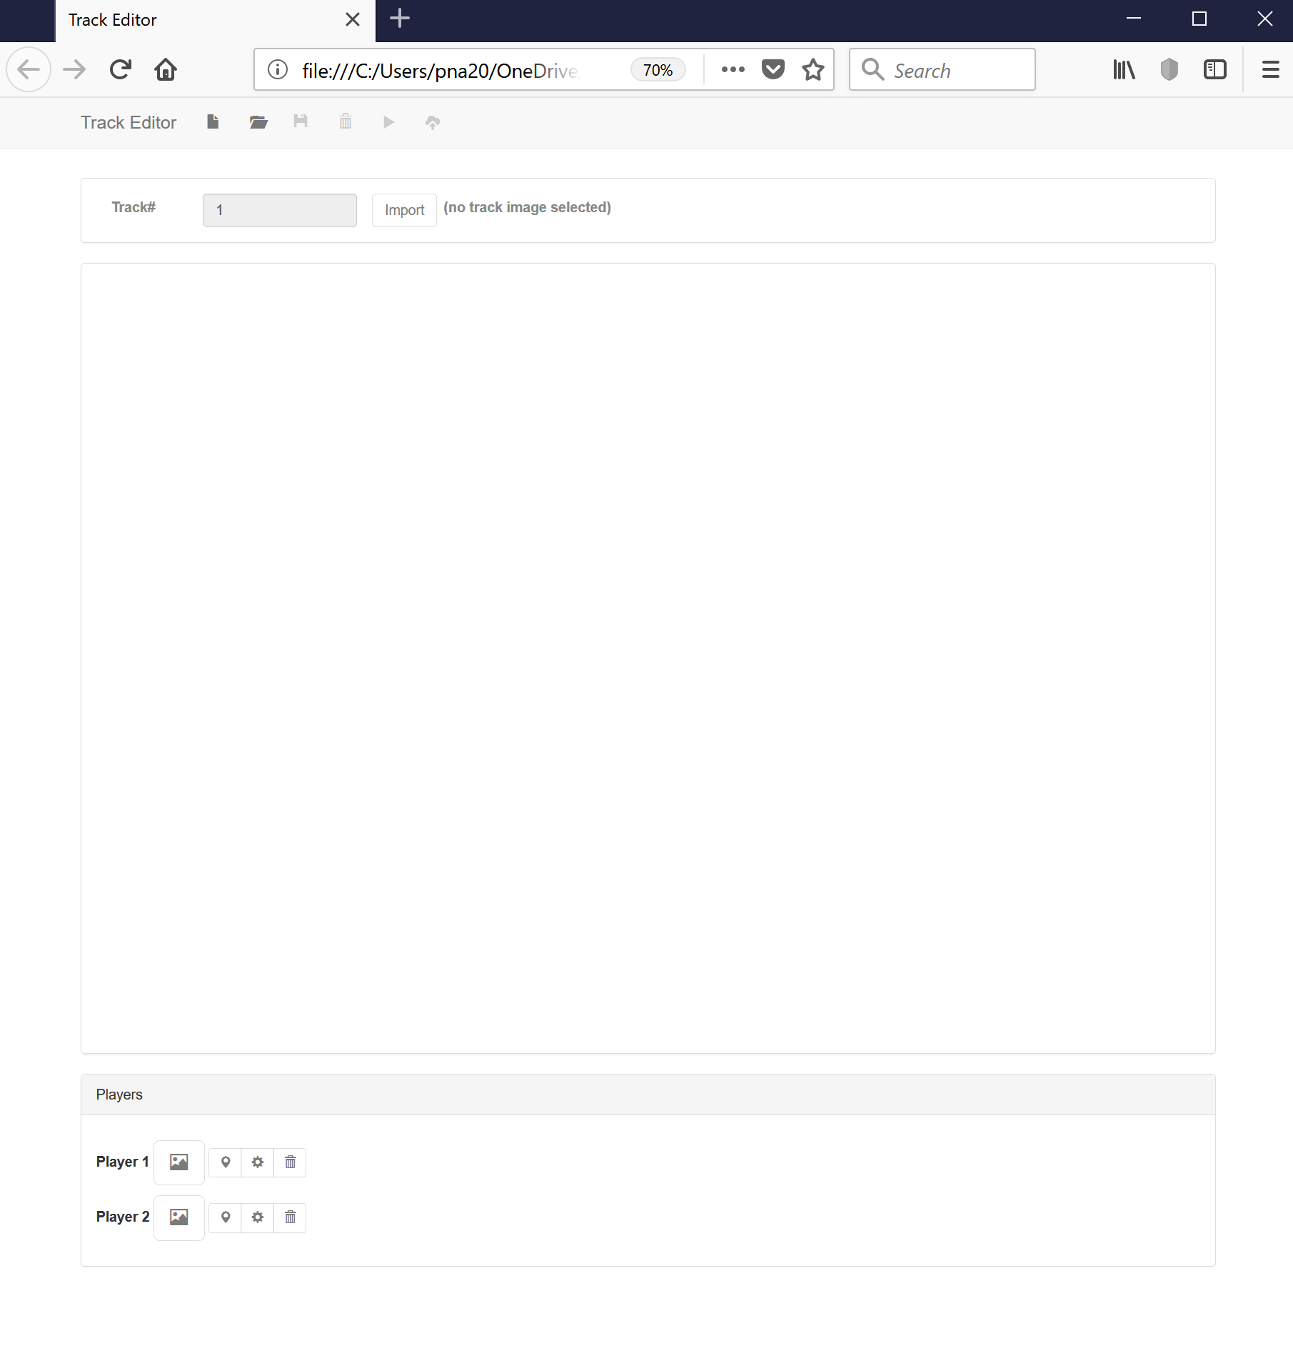
1. Track Editor Overview…
On first loading the Track Editor, you are presented with a blank canvas. Along the top of the window are icons to create a new track, open an existing track, save the current track model, delete the track model, test and export the track for use in the game.
The main track editor window consists of a dialog to set the track number (which defaults to track / level 1) and an import button to load a track image you’ve already created in an application such as Photoshop.
In addition, the main window allows you to choose an image for each player’s cars and configure where on the track it starts from, its size and which direction it is facing.
To start a new track, click the New icon [1] and select the Import button [2] to load your track image.
1
2

Slide 3
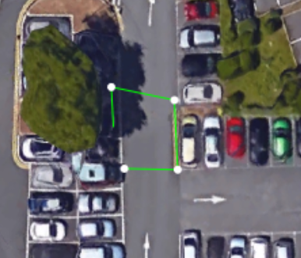
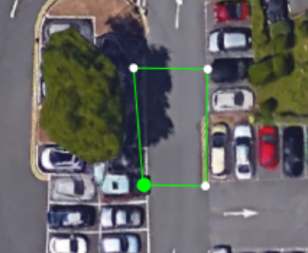
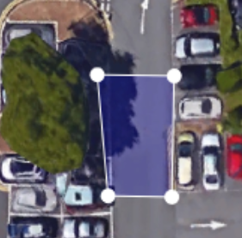
2. Creating a Track…
The track image itself has no information about the direction the players should travel in. Adding this information is the purpose of the Track Editor tool. This is done by creating a series of polygons that approximate the actual track that we see when playing the game. Each polygon represents a region the players / cars must pass through in order for the game to know they’re proceeding around the track in the correct direction.
To create the first polygon, left click on the edge of the track, near where you want the start line to be. You’ll notice a dot appear and a line follow your cursor.
Continue to click different points to define your first track polygon. To complete the polygon, move your mouse cursor over the first point you created – it will turn green.
Left click to complete the polygon. You’ll notice it will fill in in semi-transparent blue. If it’s red it means the polygon is concave. Don’t worry for now – we’ll tell you how to move points around later.

Slide 4
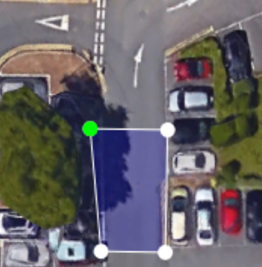
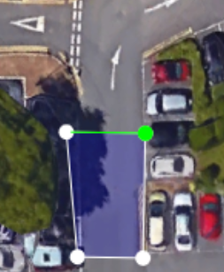
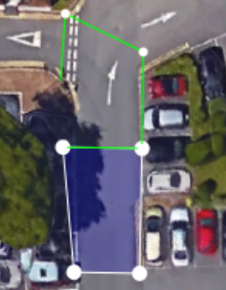
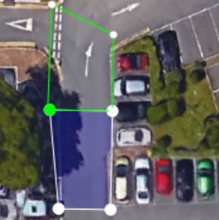
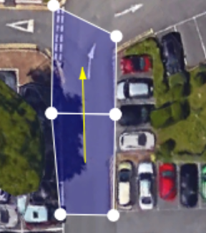
2. Creating a Track…
The track itself will need to be made up of many polygons. Let’s create another connected to the first one we created above. Move your mouse over a point on the edge of the polygon the track will head in (here it’s the top edge). As before it’ll turn green. Left click to start your second polygon.
As you trace your new polygon, select the other point on the edge – again it’ll turn green then left click to select that point.
Keep tracing the points of your new polygon as before…
Again, to complete the polygon, move your mouse over the first point of your new polygon and left click to select it.
Now, when the polygon is created, you’ll notice an arrow connecting the first polygon to the second polygon. This is showing you the direction your cars need to travel in to navigate around the track.

Slide 5
Quick tip 1…
It’s possible to move points around once a polygon has been created…
Move your mouse cursor over the point you want to move (it’ll turn green as before). Press control (ctrl) and left click the point. Now, instead of creating a new polygon, you’ll be able to drag the point around the screen. This will allow you to fine tune your polygon shapes.
You can also use this method to connect up disconnected polygons by matching points up along a shared edge.

Slide 6
Quick Tip 2
If you make a mistake you can press the delete (Del) key and this will delete the last polygon created.
If you’re tracing a polygon and make a mistake pressing “Del” will remove what you’ve traced so far so you can start your new polygon from scratch!

Slide 7
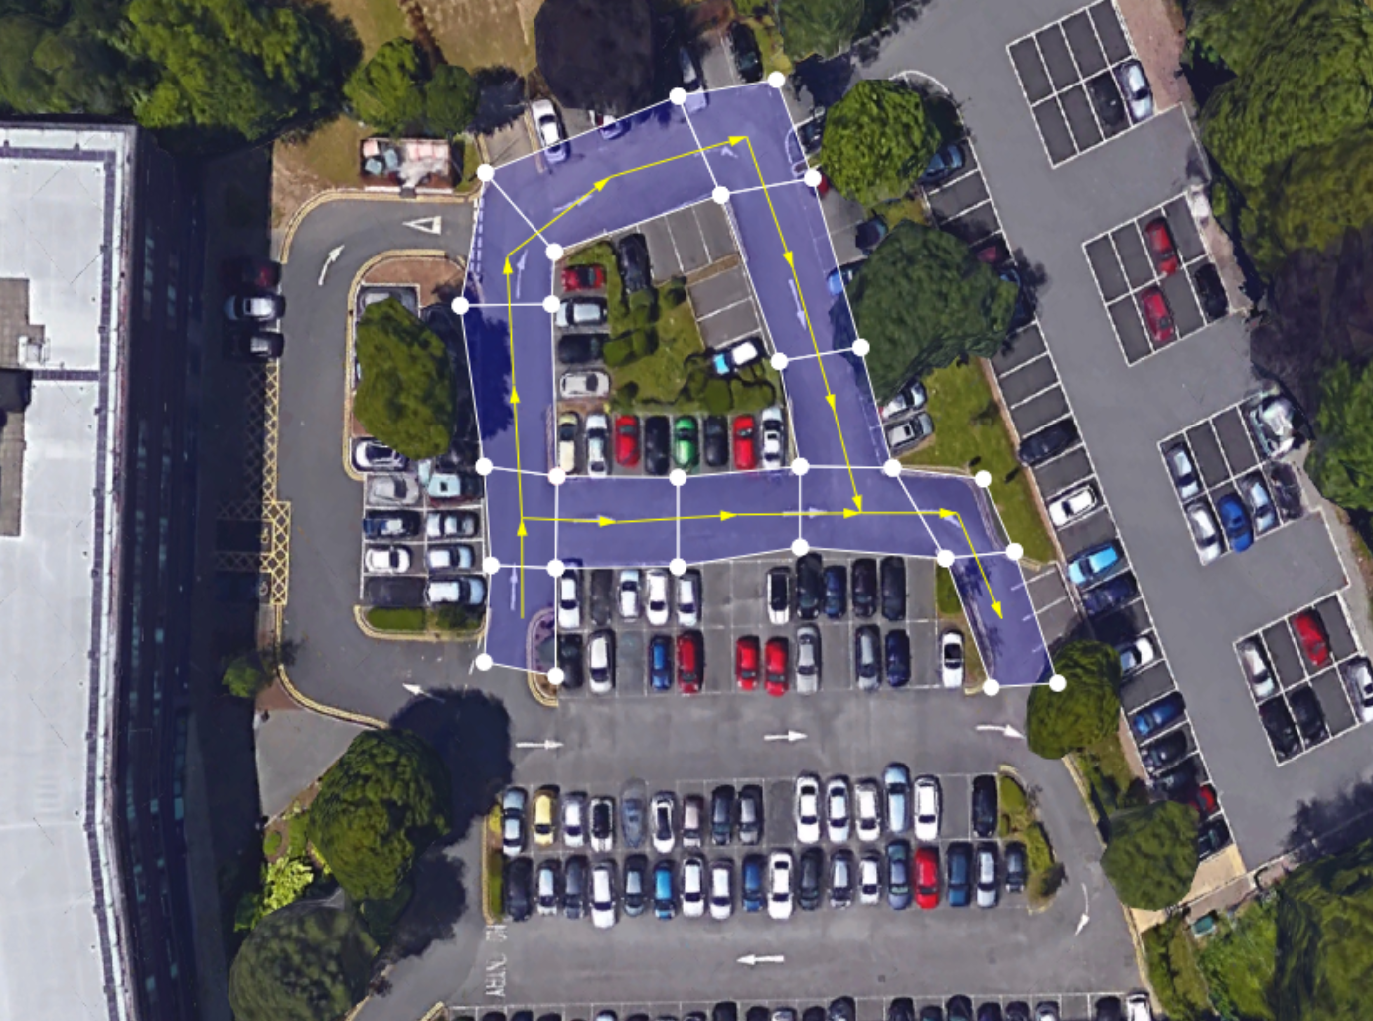
3. Branching Tracks…
5
6
4
7
The track you create can form a loop (so the last polygon you create links up with the first) or can have branches (as shown here). When you create branches, make sure to create the polygons for each branch first before creating the track polygons for where the branches merge…
3
8
2
12
9
10
11
1
In this example, the track branches at the second polygon we create (2). We create the first branch with polygons 3 – 8 and then the second branch with polygons 9 and 10. We then merge the branches by connecting them up with polygon 11 before continuing the track with polygon 12 and so on…

Slide 8
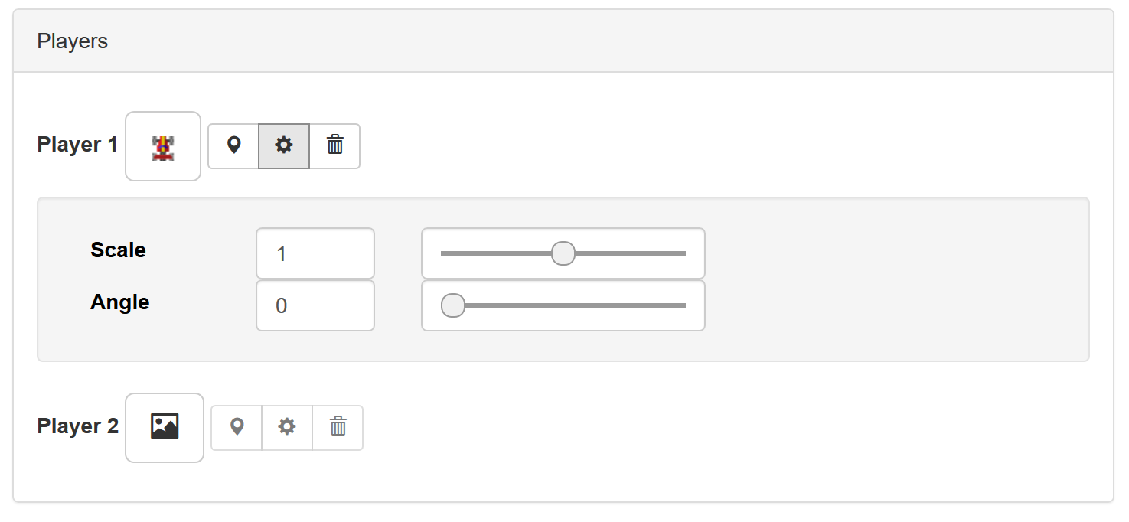
4. Player Setup…
Aside from creating the track model, the track editor allows you to specify where the players will start from. Below the main track window you’ll see the “Players” controls. These allow you to place and configure the player’s cars…
Select the car image / sprite you want to use…
Place the car on the track. Click the pin icon once then in the main track image move your mouse to where you want the player to start. You can only place the car in the first polygon of the track model!
Click the cog icon to expand the configuration controls. Here you can change the size and starting orientation of the player.
The “trash” icon can be used to delete the player setup.

Slide 9
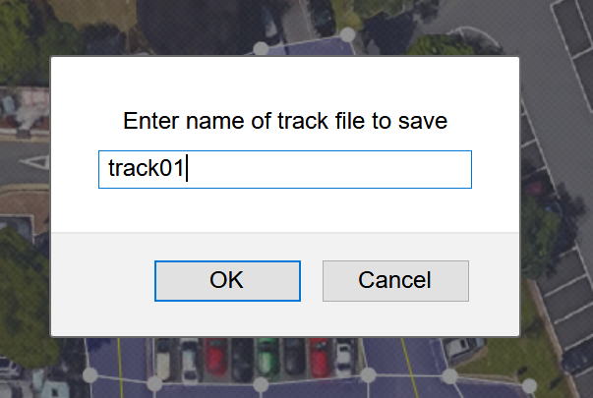
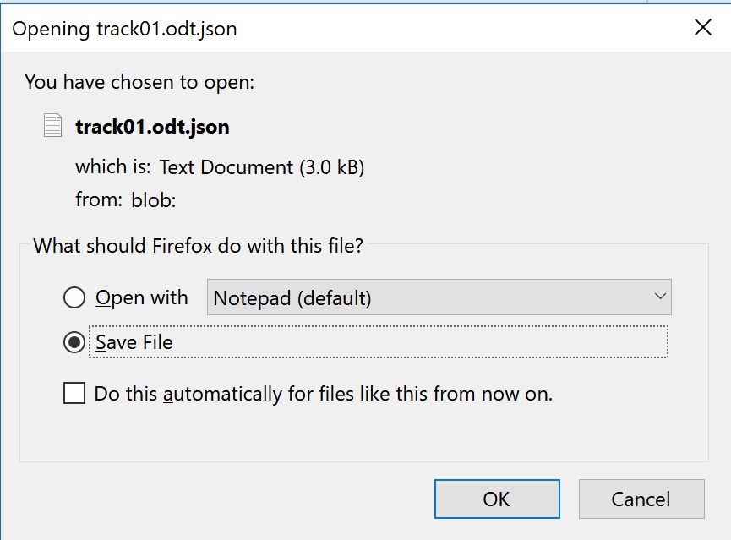
5. Saving your track model…
In game development, developers will often save data in one format to work on. This format will be different from the format used in the game engine – when playing the game we want to use a file format that is quick to load so the player doesn’t have to wait too long!!!
The track editor has a save icon at the top of the screen. Because we’re working in a browser, this will create a new file for you in your Downloads folder…
The OverDrive engine is designed to work locally on your PC, without the need of a separate server (though of course this is possible)!
As such, we don’t want to leave our track model in the Downloads folder. Instead, copy your track model file and paste it into the Editor->Models subfolder in the main project folder. This is where the track editor will expect to find your file when it loads it later.
When you click the “Save” icon you’ll be asked to enter a name for the track file. Here I’ve used “track1”…
… you’ll then be asked to Open or Save the file. We’ll Save the file! Click “OK” to do this. You’ll notice the actual file is now called track1.odt.json. This is a JSON file that contains the information about the track and player setup. You can look at this in any text editor. As noted above, this is located in your Downloads folder.

Slide 10
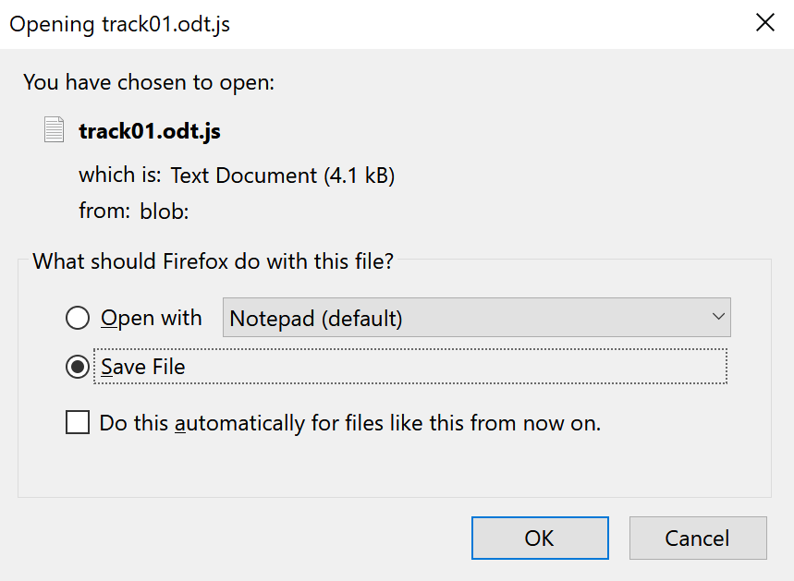
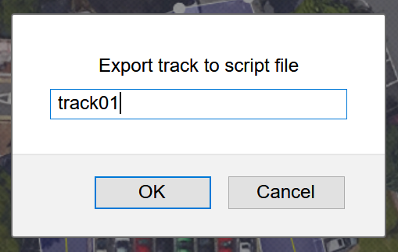
6. Exporting your track model…
Exporting the track model is different from saving. Instead of creating a JSON file to load back in later, it creates an actual JavaScript file to load into the game itself. As before, this is saved to your Downloads folder. You don’t usually export your track model until it’s finished!
As with the Save file option, we don’t want to leave our exported track in the Downloads folder. Instead, copy your track model file and paste it into the Levels subfolder in the main project folder. This is where the game engine will expect to find your file when it loads it later.
When you click the “Export” icon you’ll be asked to enter a name for the track file. Here I’ve used “track01”…
… you’ll then be asked to Open or Save the file. Again, we’ll Save the file! Click “OK” to do this. You’ll notice the actual file is now called track1.odt.js. (it may be called track01.odt.js.txt depending on the browser). Again, you can look at this in any text editor. As noted above, this will be located in your Downloads folder.

